Slide 1
Program Design
Ref: Whitten et all, Systems Analysis and Design Methods 7e. McGraw-Hill Higher Education
Mostafijur Rahman Akhond
Lecture, CSE
BRAC University

Slide 2
Outline
Moving from logical to physical process models.
Designing programs.
Structure chart.
Program specification.

Slide 3
Introduction
Program design – Analysts determine what programs will be written and create instructions for the programmers.
Various implementation decisions are made about the new system (e.g., what programming language(s) will be used.)
The DFDs created during analysis are modified to show these implementation decisions, resulting in a set of physical data flow diagrams.
The analysts determine how the processes are organized, using a structure chart to depict the decisions.
Detailed instructions called program specifications are developed.

Slide 4
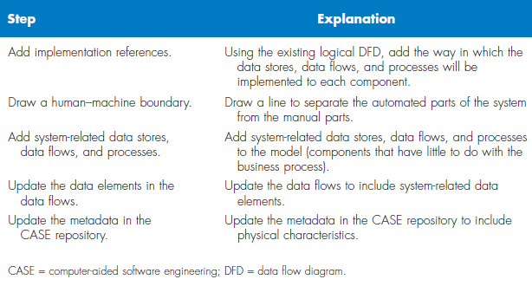
Steps to Create the Physical Data Flow Diagram

Slide 5
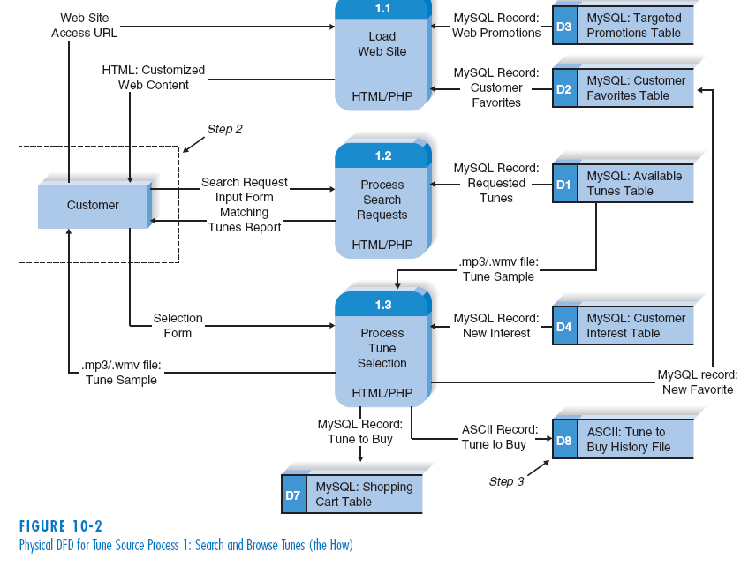
Physical DFD Example

Slide 6
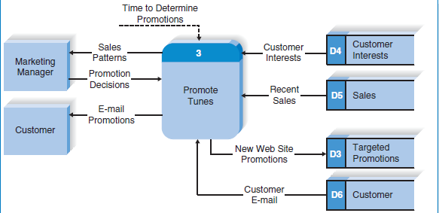
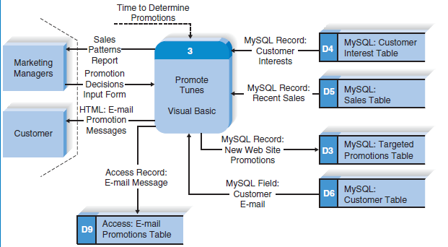
Logical to Physical dfd
Logical Model of the Promote Tunes Process
Physical Model for Promote Tunes Process

Slide 7
Structure Chart
The structure chart is an Important program design technique that help the analyst design the program.
It shows all the components of code in a hierarchical format that implies
Sequence (in what order components are invoked),
Selection (under what condition a module is invoked),
Iteration (how often a component is repeated)

Slide 8
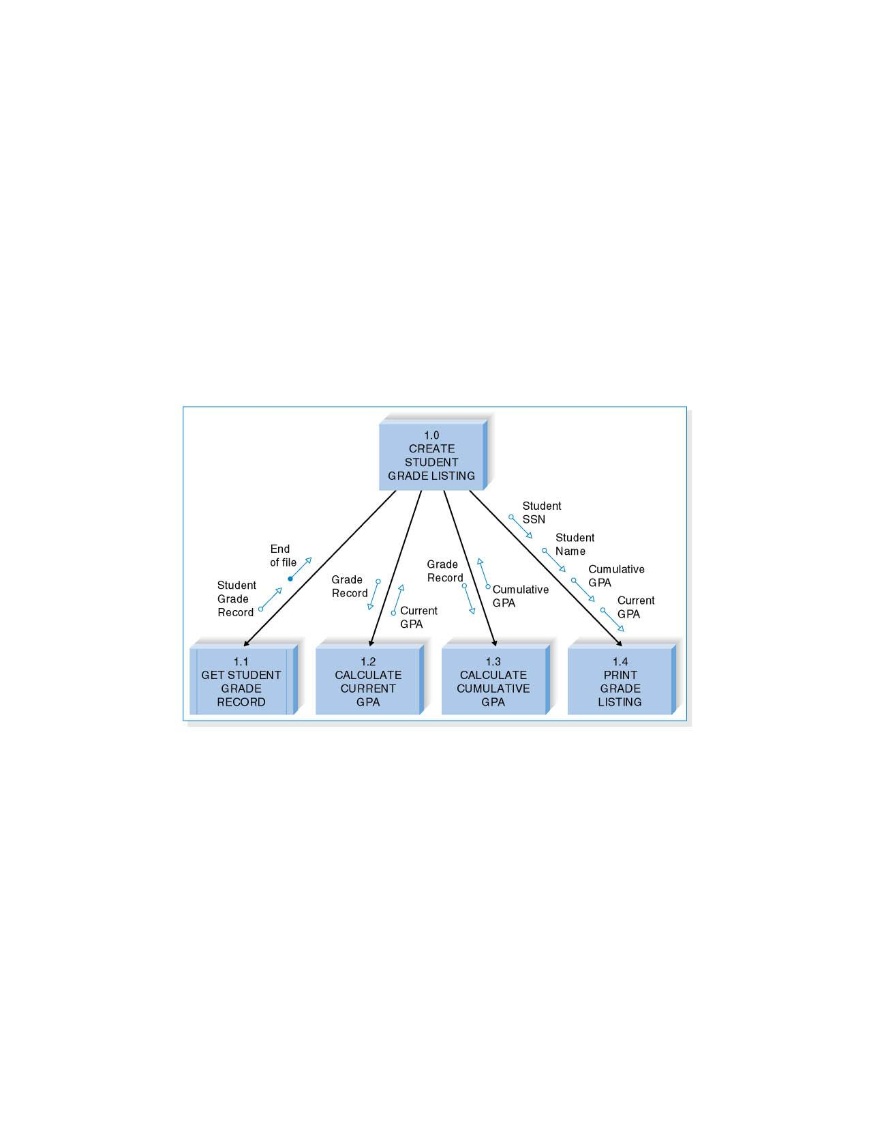
An academic system needs a program that will print a listing of students along with their grade point averages (GPAs), both for the current semester and overall. First, the program must retrieve the student grade records; then it must calculate the current and cumulative GPAs; finally, the grade list can be printed.

Slide 9
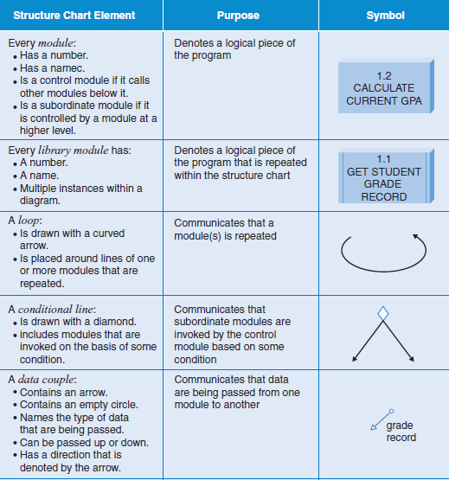
Structure chart notions

Slide 10
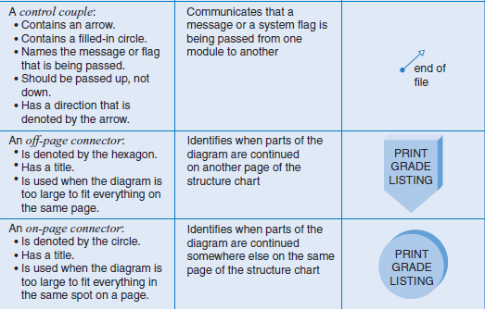
Structure chart notions (2)

Slide 11
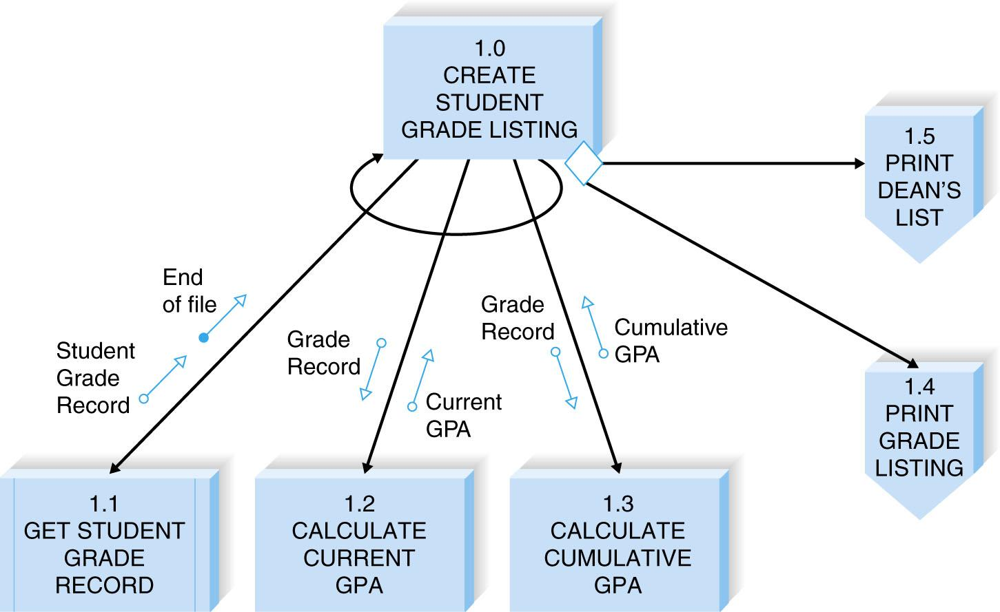
Revised Structure chart

Slide 12
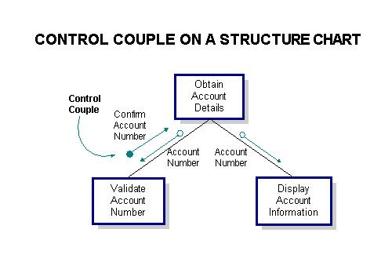
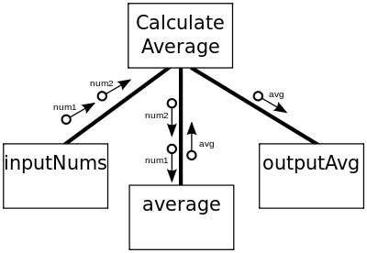

Slide 13
Design Guidelines
High quality structure charts result in programs that are modular, reusable, and easy to implement.
Measures of good design include
cohesion,
appropriate levels of fan-in and fan-out.

Slide 14
Build Modules with High Cohesion
Cohesion refers to how well the lines of code within each module relate to each other.
Cohesive modules are easy to understand and build because their code performs one function effectively.
There are various types of cohesion.
Functional cohesion – all elements of the modules contribute to performing a single task.
Temporal cohesion – functions are invoked at the same time.
Coincidental cohesion – there is no apparent relationship among a module’s functions.

Slide 15
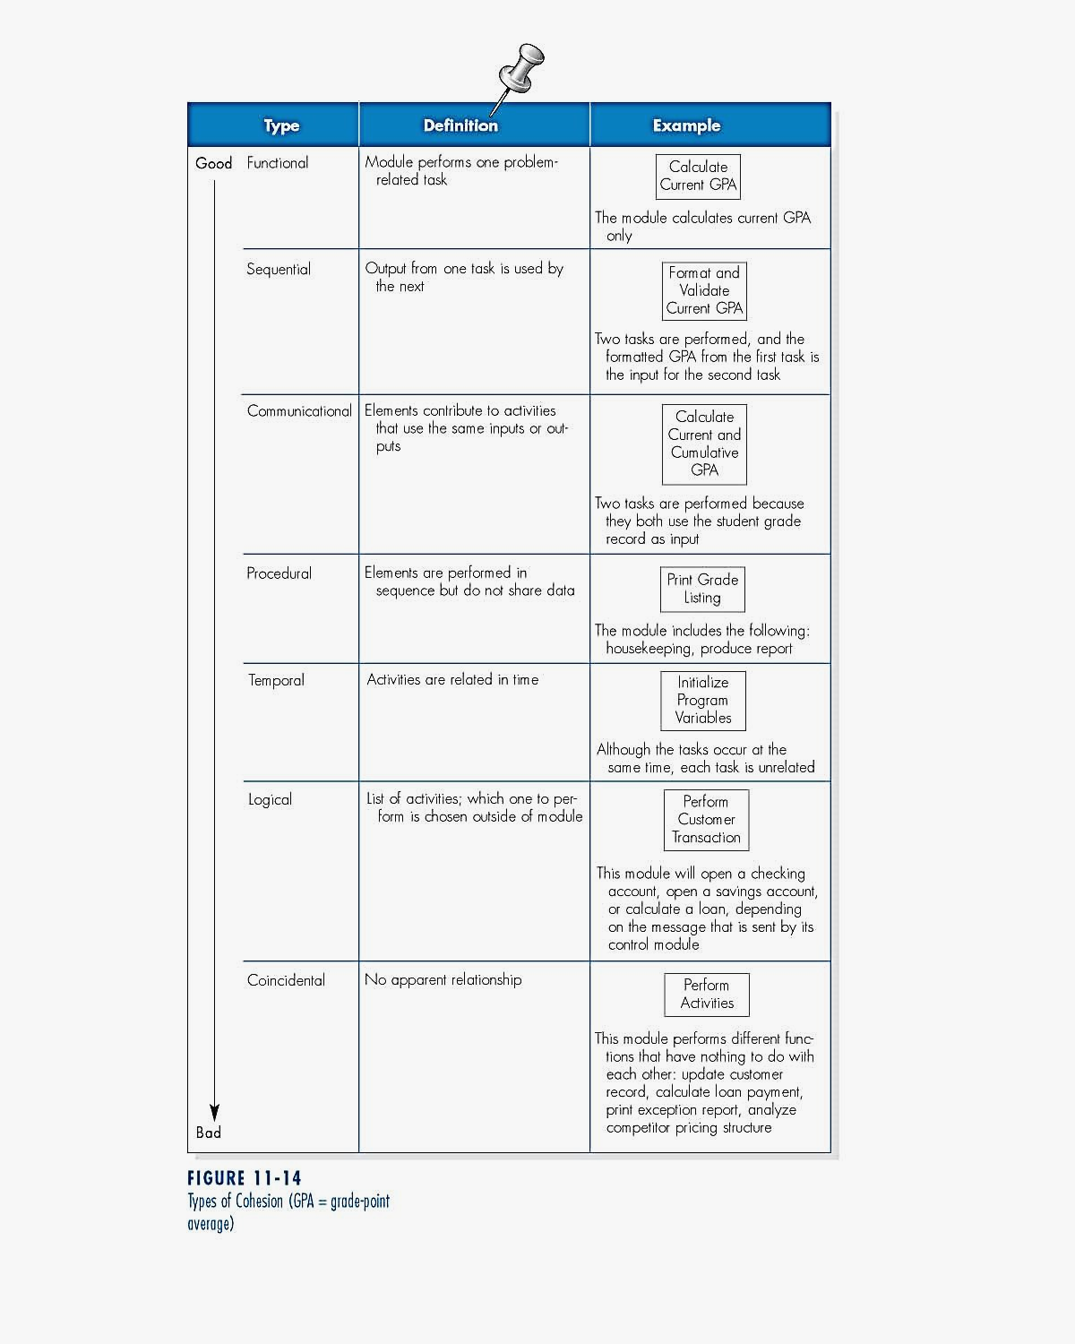

Slide 16
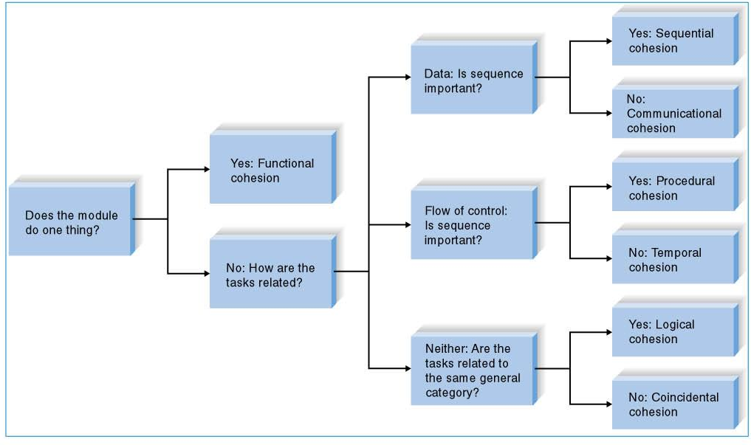
Cohesion Decision Tree

Slide 17
Create High Fan-In
Fan-in describes the number of control modules that communicate with a subordinate.
A module with high fan-in has many different control modules that call it.
- This is a good situation because high fan-in indicates that a module is reused in many places on the structure chart.

Slide 18
Avoid High Fan-Out
fan-in is call by other modules.
fanout is call from that module.
A large number of subordinates associated with a single control should be avoided.
The general rule of thumb is to limit a control module’s subordinates to approximately seven for low fan-out.

Slide 19
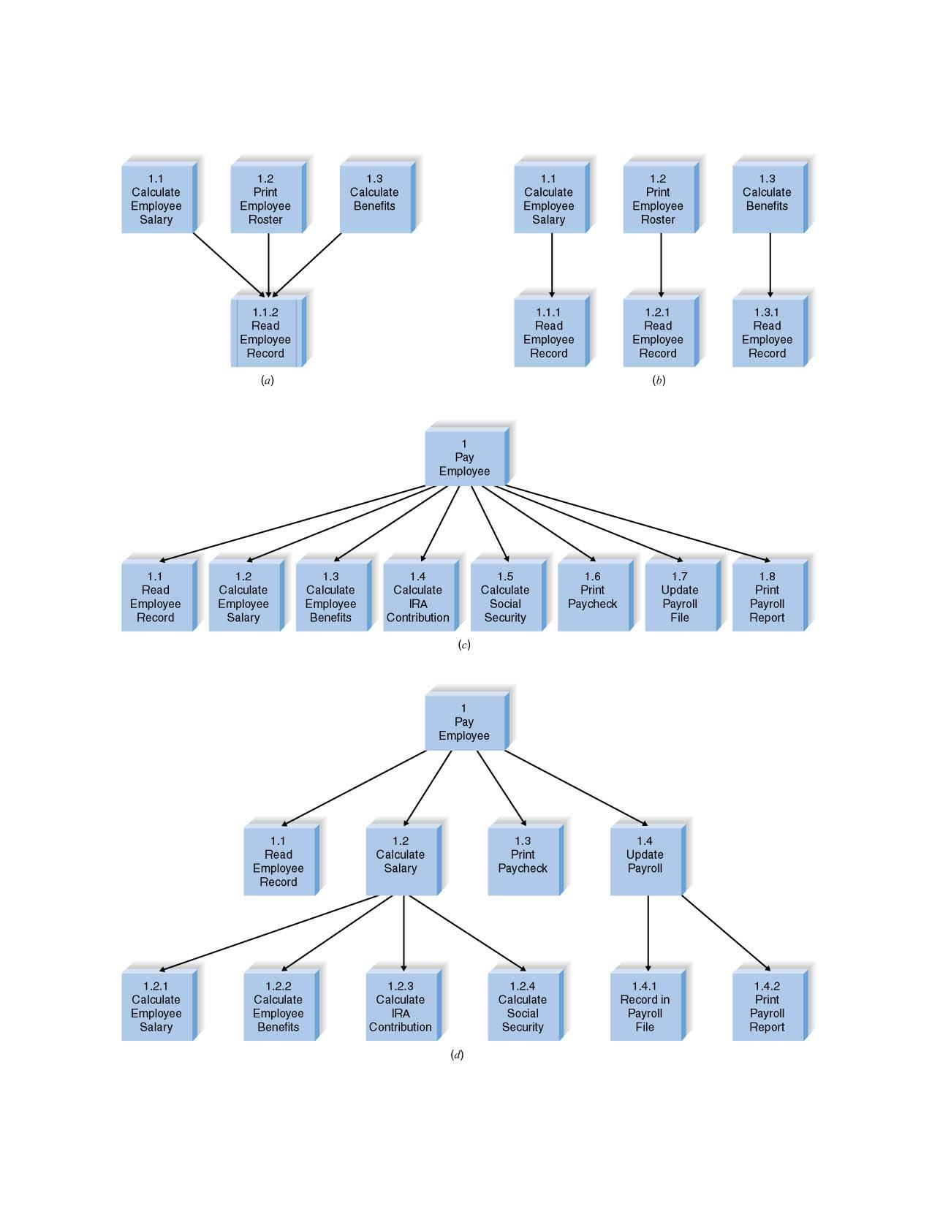
Examples of Fan-in and Fan-out

Slide 20
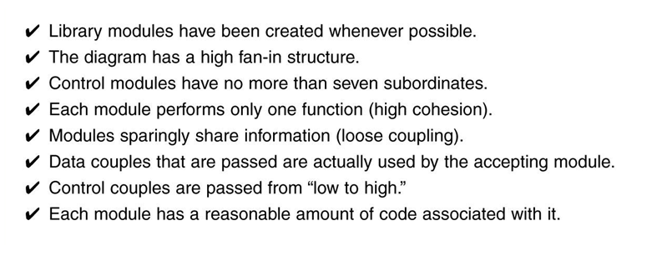
Check list for structure chart quality

Slide 21
Program Specification
Program Specifications are documents that include explicit instructions on how to program pieces of code.
There is no formal syntax for program specification.
Four components are essential for program specification:
- Program information;
- Events;
- Inputs and outputs; and
- Pseudocode – a detailed outline of lines of code that need to be written.
- Additional notes and comments can also be included.

Slide 22
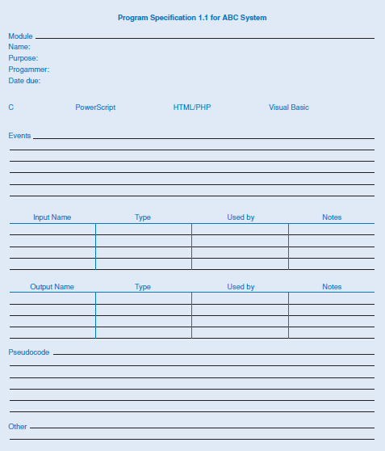

Slide 23
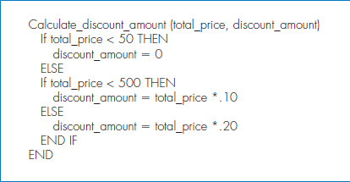
Pseudocode Example

Slide 24
Summery
Moving from logical to physical process models.
- Physical DFDs show implementation details.
Structure chart.
- The structure chart shows all of the functional components needed in the program at a high level.
Building structure chart.
- Module, control connection, couples, review.
Structure chart design guidelines.
- Cohesion, coupling, and fan-in/fan-out.
Program specifications.
- Program specifications provide more detailed instructions to the programmers.

